Slide 1
Chapter 10: Storage and File Structure
Notes:
‹#›

Slide 2
Chapter 10: Storage and File Structure
Overview of Physical Storage Media
Magnetic Disks
RAID
Tertiary Storage
Storage Access
File Organization
Organization of Records in Files
Data-Dictionary Storage
Notes:
‹#›

Slide 3
Classification of Physical Storage Media
Speed with which data can be accessed
Cost per unit of data
Reliability
data loss on power failure or system crash
physical failure of the storage device
Can differentiate storage into:
volatile storage: loses contents when power is switched off
non-volatile storage:
Contents persist even when power is switched off.
Includes secondary and tertiary storage, as well as batter- backed up main-memory.
Notes:
‹#›

Slide 4
Physical Storage Media
Cache – fastest and most costly form of storage; volatile; managed by the computer system hardware.
Main memory:
fast access (10s to 100s of nanoseconds; 1 nanosecond = 10^{–9} seconds)
generally too small (or too expensive) to store the entire database
capacities of up to a few Gigabytes widely used currently
Capacities have gone up and per-byte costs have decreased steadily and rapidly (roughly factor of 2 every 2 to 3 years)
Volatile — contents of main memory are usually lost if a power failure or system crash occurs.
Notes:
‹#›

Slide 5
Physical Storage Media (Cont.)
Flash memory
Data survives power failure
Data can be written at a location only once, but location can be erased and written to again
Can support only a limited number (10K – 1M) of write/erase cycles.
Erasing of memory has to be done to an entire bank of memory
Reads are roughly as fast as main memory
But writes are slow (few microseconds), erase is slower
Widely used in embedded devices such as digital cameras, phones, and USB keys
Notes:
‹#›

Slide 6
Physical Storage Media (Cont.)
Magnetic-disk
Data is stored on spinning disk, and read/written magnetically
Primary medium for the long-term storage of data; typically stores entire database.
Data must be moved from disk to main memory for access, and written back for storage
Much slower access than main memory (more on this later)
direct-access – possible to read data on disk in any order, unlike magnetic tape
Capacities range up to roughly 1.5 TB as of 2009
Much larger capacity and cost/byte than main memory/flash memory
Growing constantly and rapidly with technology improvements (factor of 2 to 3 every 2 years)
Survives power failures and system crashes
disk failure can destroy data, but is rare
Notes:
‹#›

Slide 7
Physical Storage Media (Cont.)
Optical storage
non-volatile, data is read optically from a spinning disk using a laser
CD-ROM (640 MB) and DVD (4.7 to 17 GB) most popular forms
Blu-ray disks: 27 GB to 54 GB
Write-one, read-many (WORM) optical disks used for archival storage (CD-R, DVD-R, DVD+R)
Multiple write versions also available (CD-RW, DVD-RW, DVD+RW, and DVD-RAM)
Reads and writes are slower than with magnetic disk
Juke-box systems, with large numbers of removable disks, a few drives, and a mechanism for automatic loading/unloading of disks available for storing large volumes of data
Notes:
‹#›

Slide 8
Physical Storage Media (Cont.)
Tape storage
non-volatile, used primarily for backup (to recover from disk failure), and for archival data
sequential-access – much slower than disk
very high capacity (40 to 300 GB tapes available)
tape can be removed from drive ⇒ storage costs much cheaper than disk, but drives are expensive
Tape jukeboxes available for storing massive amounts of data
hundreds of terabytes (1 terabyte = 10⁹ bytes) to even multiple petabytes (1 petabyte = 10¹² bytes)
Notes:
‹#›

Slide 9
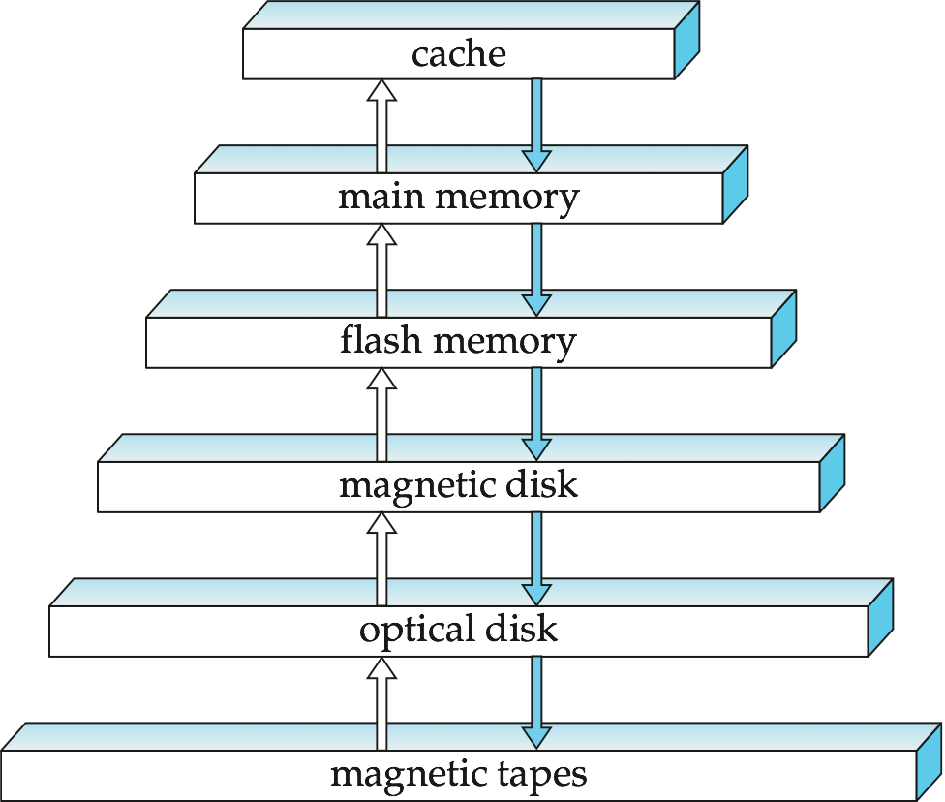
Storage Hierarchy
Notes:
‹#›

Slide 10
Storage Hierarchy (Cont.)
primary storage: Fastest media but volatile (cache, main memory).
secondary storage: next level in hierarchy, non-volatile, moderately fast access time
also called on-line storage
E.g. flash memory, magnetic disks
tertiary storage: lowest level in hierarchy, non-volatile, slow access time
also called off-line storage
E.g. magnetic tape, optical storage
Notes:
‹#›

Slide 11
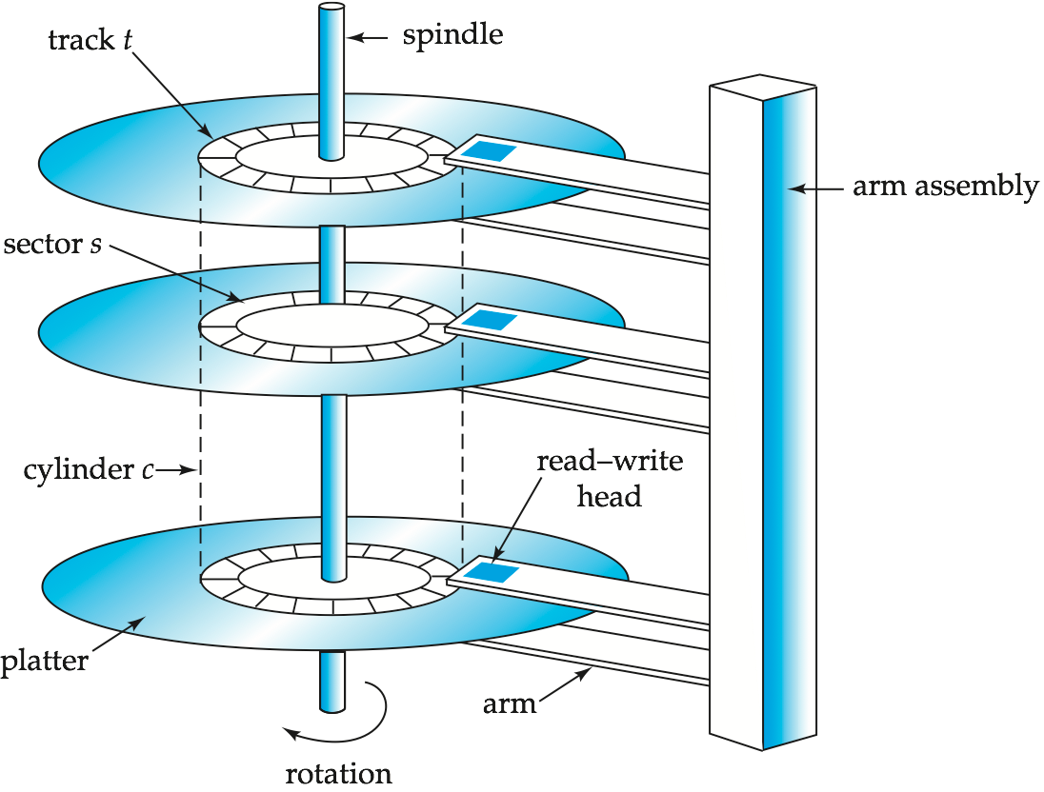
Magnetic Hard Disk Mechanism
NOTE: Diagram is schematic, and simplifies the structure of actual disk drives
Notes:
‹#›

Slide 12
Magnetic Disks
Read-write head
Positioned very close to the platter surface (almost touching it)
Reads or writes magnetically encoded information.
Surface of platter divided into circular tracks
Over 50K-100K tracks per platter on typical hard disks
Each track is divided into sectors.
A sector is the smallest unit of data that can be read or written.
Sector size typically 512 bytes
Typical sectors per track: 500 to 1000 (on inner tracks) to 1000 to 2000 (on outer tracks)
To read/write a sector
disk arm swings to position head on right track
platter spins continually; data is read/written as sector passes under head
Head-disk assemblies
multiple disk platters on a single spindle (1 to 5 usually)
one head per platter, mounted on a common arm.
Cylinder i consists of i^{th} track of all the platters
Notes:
‹#›

Slide 13
Magnetic Disks (Cont.)
Earlier generation disks were susceptible to head-crashes
Surface of earlier generation disks had metal-oxide coatings which would disintegrate on head crash and damage all data on disk
Current generation disks are less susceptible to such disastrous failures, although individual sectors may get corrupted
Disk controller – interfaces between the computer system and the disk drive hardware.
accepts high-level commands to read or write a sector
initiates actions such as moving the disk arm to the right track and actually reading or writing the data
Computes and attaches checksums to each sector to verify that data is read back correctly
If data is corrupted, with very high probability stored checksum won’t match recomputed checksum
Ensures successful writing by reading back sector after writing it
Performs remapping of bad sectors
Notes:
‹#›

Slide 14
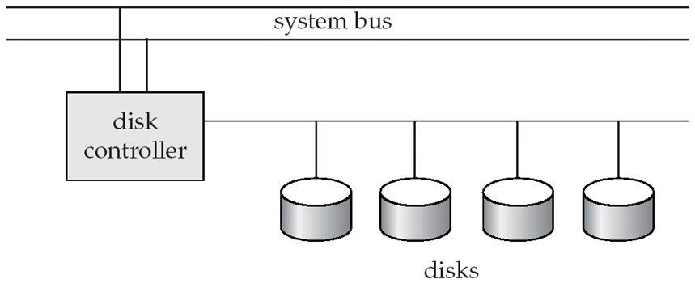
Disk Subsystem
Multiple disks connected to a computer system through a controller
Controllers functionality (checksum, bad sector remapping) often carried out by individual disks; reduces load on controller
Disk interface standards families
ATA (AT adaptor) range of standards
SATA (Serial ATA)
SCSI (Small Computer System Interconnect) range of standards
SAS (Serial Attached SCSI)
Several variants of each standard (different speeds and capabilities)
Notes:
‹#›

Slide 15
Disk Subsystem
Disks usually connected directly to computer system
In Storage Area Networks (SAN), a large number of disks are connected by a high-speed network to a number of servers
In Network Attached Storage (NAS) networked storage provides a file system interface using networked file system protocol, instead of providing a disk system interface

Slide 16
Performance Measures of Disks
Access time – the time it takes from when a read or write request is issued to when data transfer begins. Consists of:
Seek time – time it takes to reposition the arm over the correct track.
Average seek time is 1/2 the worst case seek time.
Would be 1/3 if all tracks had the same number of sectors, and we ignore the time to start and stop arm movement
4 to 10 milliseconds on typical disks
Rotational latency – time it takes for the sector to be accessed to appear under the head.
Average latency is 1/2 of the worst case latency.
4 to 11 milliseconds on typical disks (5400 to 15000 r.p.m.)
Data-transfer rate – the rate at which data can be retrieved from or stored to the disk.
25 to 100 MB per second max rate, lower for inner tracks
Multiple disks may share a controller, so rate that controller can handle is also important
E.g. SATA: 150 MB/sec, SATA-II 3Gb (300 MB/sec)
Ultra 320 SCSI: 320 MB/s, SAS (3 to 6 Gb/sec)
Fiber Channel (FC2Gb or 4Gb): 256 to 512 MB/s
Notes:
‹#›

Slide 17
Performance Measures (Cont.)
Mean time to failure (MTTF) – the average time the disk is expected to run continuously without any failure.
Typically 3 to 5 years
Probability of failure of new disks is quite low, corresponding to a “theoretical MTTF” of 500,000 to 1,200,000 hours for a new disk
E.g., an MTTF of 1,200,000 hours for a new disk means that given 1000 relatively new disks, on an average one will fail every 1200 hours
MTTF decreases as disk ages
Notes:
‹#›

Slide 18
Optimization of Disk-Block Access
Block – a contiguous sequence of sectors from a single track
data is transferred between disk and main memory in blocks
sizes range from 512 bytes to several kilobytes
Smaller blocks: more transfers from disk
Larger blocks: more space wasted due to partially filled blocks
Typical block sizes today range from 4 to 16 kilobytes
Disk-arm-scheduling algorithms order pending accesses to tracks so that disk arm movement is minimized
elevator algorithm:
R6
R3
R1
R5
R2
R4
Inner track
Outer track
Notes:
‹#›

Slide 19
Optimization of Disk Block Access (Cont.)
File organization – optimize block access time by organizing the blocks to correspond to how data will be accessed
E.g. Store related information on the same or nearby cylinders.
Files may get fragmented over time
E.g. if data is inserted to/deleted from the file
Or free blocks on disk are scattered, and newly created file has its blocks scattered over the disk
Sequential access to a fragmented file results in increased disk arm movement
Some systems have utilities to defragment the file system, in order to speed up file access
Notes:
‹#›

Slide 20
Optimization of Disk Block Access (Cont.)
Nonvolatile write buffers speed up disk writes by writing blocks to a non-volatile RAM buffer immediately
Non-volatile RAM: battery backed up RAM or flash memory
Even if power fails, the data is safe and will be written to disk when power returns
Controller then writes to disk whenever the disk has no other requests or request has been pending for some time
Database operations that require data to be safely stored before continuing can continue without waiting for data to be written to disk
Writes can be reordered to minimize disk arm movement
Log disk – a disk devoted to writing a sequential log of block updates
Used exactly like nonvolatile RAM
Write to log disk is very fast since no seeks are required
No need for special hardware (NV-RAM)
File systems typically reorder writes to disk to improve performance
Journaling file systems write data in safe order to NV-RAM or log disk
Reordering without journaling: risk of corruption of file system data
Notes:
‹#›

Slide 21
Flash Storage
NOR flash vs NAND flash
NAND flash
used widely for storage, since it is much cheaper than NOR flash
requires page-at-a-time read (page: 512 bytes to 4 KB)
transfer rate around 20 MB/sec
solid state disks: use multiple flash storage devices to provide higher transfer rate of 100 to 200 MB/sec
erase is very slow (1 to 2 millisecs)
erase block contains multiple pages
remapping of logical page addresses to physical page addresses avoids waiting for erase
translation table tracks mapping
also stored in a label field of flash page
remapping carried out by flash translation layer
after 100,000 to 1,000,000 erases, erase block becomes unreliable and cannot be used
wear leveling

Slide 22
RAID
RAID: Redundant Arrays of Independent Disks
disk organization techniques that manage a large numbers of disks, providing a view of a single disk of
high capacity and high speed by using multiple disks in parallel,
high reliability by storing data redundantly, so that data can be recovered even if a disk fails
The chance that some disk out of a set of N disks will fail is much higher than the chance that a specific single disk will fail.
E.g., a system with 100 disks, each with MTTF of 100,000 hours (approx. 11 years), will have a system MTTF of 1000 hours (approx. 41 days)
Techniques for using redundancy to avoid data loss are critical with large numbers of disks
Originally a cost-effective alternative to large, expensive disks
I in RAID originally stood for ``inexpensive’’
Today RAIDs are used for their higher reliability and bandwidth.
The “I” is interpreted as independent
Notes:
‹#›

Slide 23
Improvement of Reliability via Redundancy
Redundancy – store extra information that can be used to rebuild information lost in a disk failure
E.g., Mirroring (or shadowing)
Duplicate every disk. Logical disk consists of two physical disks.
Every write is carried out on both disks
Reads can take place from either disk
If one disk in a pair fails, data still available in the other
Data loss would occur only if a disk fails, and its mirror disk also fails before the system is repaired
Probability of combined event is very small
Except for dependent failure modes such as fire or building collapse or electrical power surges
Mean time to data loss depends on mean time to failure, and mean time to repair
E.g. MTTF of 100,000 hours, mean time to repair of 10 hours gives mean time to data loss of 500*10⁶ hours (or 57,000 years) for a mirrored pair of disks (ignoring dependent failure modes)
Notes:
‹#›

Slide 24
Improvement in Performance via Parallelism
Two main goals of parallelism in a disk system:
1. Load balance multiple small accesses to increase throughput
2. Parallelize large accesses to reduce response time.
Improve transfer rate by striping data across multiple disks.
Bit-level striping – split the bits of each byte across multiple disks
In an array of eight disks, write bit i of each byte to disk i.
Each access can read data at eight times the rate of a single disk.
But seek/access time worse than for a single disk
Bit level striping is not used much any more
Block-level striping – with n disks, block i of a file goes to disk (i mod n) + 1
Requests for different blocks can run in parallel if the blocks reside on different disks
A request for a long sequence of blocks can utilize all disks in parallel
Notes:
‹#›

Slide 25
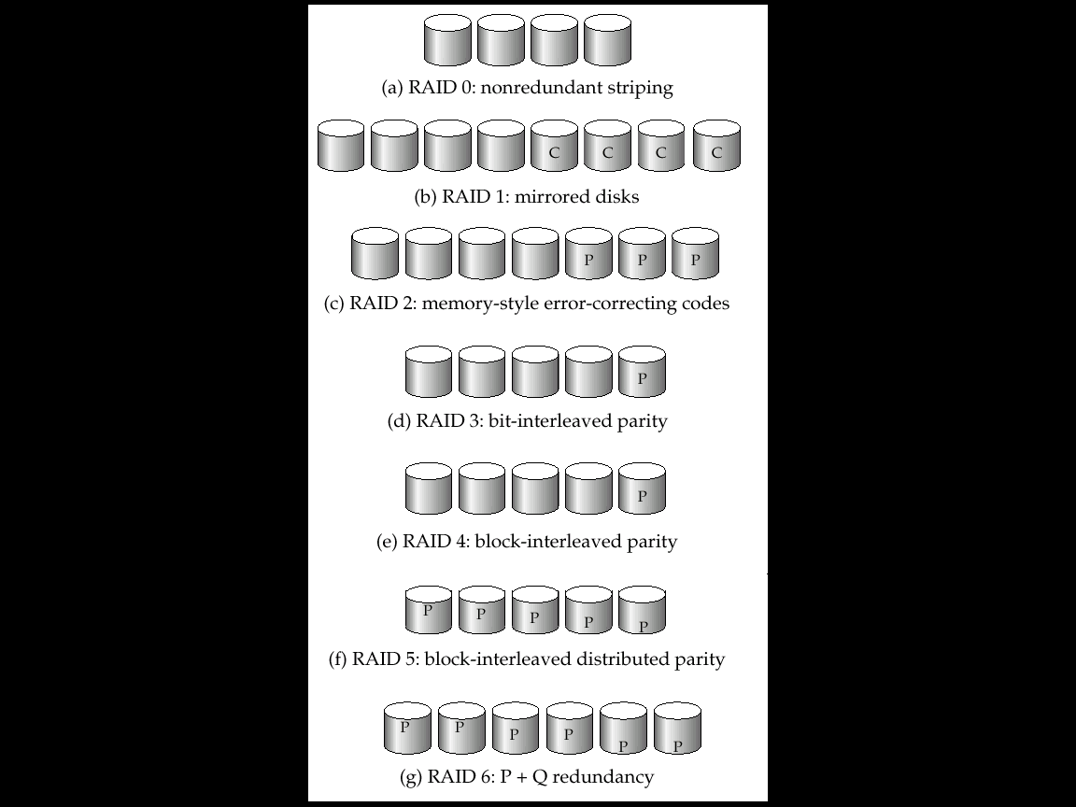
RAID Levels
Schemes to provide redundancy at lower cost by using disk striping combined with parity bits
Different RAID organizations, or RAID levels, have differing cost, performance and reliability characteristics
RAID Level 0: Block striping; non-redundant.
Used in high-performance applications where data loss is not critical.
RAID Level 1: Mirrored disks with block striping
Offers best write performance.
Popular for applications such as storing log files in a database system.
Notes:
‹#›

Slide 26
RAID Levels (Cont.)
RAID Level 2: Memory-Style Error-Correcting-Codes (ECC) with bit striping.
RAID Level 3: Bit-Interleaved Parity
a single parity bit is enough for error correction, not just detection, since we know which disk has failed
When writing data, corresponding parity bits must also be computed and written to a parity bit disk
To recover data in a damaged disk, compute XOR of bits from other disks (including parity bit disk)
Notes:
‹#›

Slide 27
RAID Levels (Cont.)
RAID Level 3 (Cont.)
Faster data transfer than with a single disk, but fewer I/Os per second since every disk has to participate in every I/O.
Subsumes Level 2 (provides all its benefits, at lower cost).
RAID Level 4: Block-Interleaved Parity; a single parity bit is enough for error correction, not just detection, since we know which disk has failed
When writing data, corresponding parity bits must also be computed and written to a parity bit disk
To recover data in a damaged disk, compute XOR of bits from other disks (including parity bit disk)
Notes:
‹#›

Slide 28
RAID Levels (Cont.)
RAID Level 4 (Cont.)
Provides higher I/O rates for independent block reads than Level 3
block read goes to a single disk, so blocks stored on different disks can be read in parallel
Provides high transfer rates for reads of multiple blocks than no-striping
Before writing a block, parity data must be computed
Can be done by using old parity block, old value of current block and new value of current block (2 block reads + 2 block writes)
Or by recomputing the parity value using the new values of blocks corresponding to the parity block
More efficient for writing large amounts of data sequentially
Parity block becomes a bottleneck for independent block writes since every block write also writes to parity disk
Notes:
‹#›

Slide 29
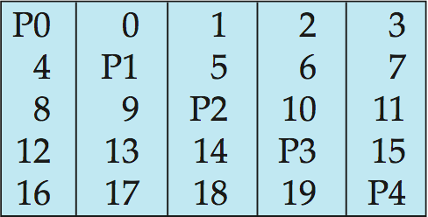
RAID Levels (Cont.)
RAID Level 5: Block-Interleaved Distributed Parity; partitions data and parity among all N + 1 disks, rather than storing data in N disks and parity in 1 disk.
E.g., with 5 disks, parity block for nth set of blocks is stored on disk (n mod 5) + 1, with the data blocks stored on the other 4 disks.
Notes:
‹#›

Slide 30
RAID Levels (Cont.)
RAID Level 5 (Cont.)
Higher I/O rates than Level 4.
Block writes occur in parallel if the blocks and their parity blocks are on different disks.
Subsumes Level 4: provides same benefits, but avoids bottleneck of parity disk.
RAID Level 6: P+Q Redundancy scheme; similar to Level 5, but stores extra redundant information to guard against multiple disk failures.
Better reliability than Level 5 at a higher cost; not used as widely.
Notes:
‹#›

Slide 31
Choice of RAID Level
Factors in choosing RAID level
Monetary cost
Performance: Number of I/O operations per second, and bandwidth during normal operation
Performance during failure
Performance during rebuild of failed disk
Including time taken to rebuild failed disk
RAID 0 is used only when data safety is not important
E.g. data can be recovered quickly from other sources
Level 2 and 4 never used since they are subsumed by 3 and 5
Level 3 is not used anymore since bit-striping forces single block reads to access all disks, wasting disk arm movement, which block striping (level 5) avoids
Level 6 is rarely used since levels 1 and 5 offer adequate safety for most applications
Notes:
‹#›

Slide 32
Choice of RAID Level (Cont.)
Level 1 provides much better write performance than level 5
Level 5 requires at least 2 block reads and 2 block writes to write a single block, whereas Level 1 only requires 2 block writes
Level 1 preferred for high update environments such as log disks
Level 1 had higher storage cost than level 5
disk drive capacities increasing rapidly (50%/year) whereas disk access times have decreased much less (x 3 in 10 years)
I/O requirements have increased greatly, e.g. for Web servers
When enough disks have been bought to satisfy required rate of I/O, they often have spare storage capacity
so there is often no extra monetary cost for Level 1!
Level 5 is preferred for applications with low update rate, and large amounts of data
Level 1 is preferred for all other applications
Notes:
‹#›

Slide 33
Hardware Issues
Software RAID: RAID implementations done entirely in software, with no special hardware support
Hardware RAID: RAID implementations with special hardware
Use non-volatile RAM to record writes that are being executed
Beware: power failure during write can result in corrupted disk
E.g. failure after writing one block but before writing the second in a mirrored system
Such corrupted data must be detected when power is restored
Recovery from corruption is similar to recovery from failed disk
NV-RAM helps to efficiently detected potentially corrupted blocks
Otherwise all blocks of disk must be read and compared with mirror/parity block
Notes:
‹#›

Slide 34
Hardware Issues (Cont.)
Latent failures: data successfully written earlier gets damaged
can result in data loss even if only one disk fails
Data scrubbing:
continually scan for latent failures, and recover from copy/parity
Hot swapping: replacement of disk while system is running, without power down
Supported by some hardware RAID systems,
reduces time to recovery, and improves availability greatly
Many systems maintain spare disks which are kept online, and used as replacements for failed disks immediately on detection of failure
Reduces time to recovery greatly
Many hardware RAID systems ensure that a single point of failure will not stop the functioning of the system by using
Redundant power supplies with battery backup
Multiple controllers and multiple interconnections to guard against controller/interconnection failures
Notes:
‹#›

Slide 35
Optical Disks
Compact disk-read only memory (CD-ROM)
Removable disks, 640 MB per disk
Seek time about 100 msec (optical read head is heavier and slower)
Higher latency (3000 RPM) and lower data-transfer rates (3-6 MB/s) compared to magnetic disks
Digital Video Disk (DVD)
DVD-5 holds 4.7 GB , and DVD-9 holds 8.5 GB
DVD-10 and DVD-18 are double sided formats with capacities of 9.4 GB and 17 GB
Blu-ray DVD: 27 GB (54 GB for double sided disk)
Slow seek time, for same reasons as CD-ROM
Record once versions (CD-R and DVD-R) are popular
data can only be written once, and cannot be erased.
high capacity and long lifetime; used for archival storage
Multi-write versions (CD-RW, DVD-RW, DVD+RW and DVD-RAM) also available
Notes:
‹#›

Slide 36
Magnetic Tapes
Hold large volumes of data and provide high transfer rates
Few GB for DAT (Digital Audio Tape) format, 10-40 GB with DLT (Digital Linear Tape) format, 100 GB+ with Ultrium format, and 330 GB with Ampex helical scan format
Transfer rates from few to 10s of MB/s
Tapes are cheap, but cost of drives is very high
Very slow access time in comparison to magnetic and optical disks
limited to sequential access.
Some formats (Accelis) provide faster seek (10s of seconds) at cost of lower capacity
Used mainly for backup, for storage of infrequently used information, and as an off-line medium for transferring information from one system to another.
Tape jukeboxes used for very large capacity storage
Multiple petabyes (10¹⁵ bytes)
Notes:
‹#›

Slide 37
File Organization, Record Organization and Storage Access

Slide 38
File Organization
The database is stored as a collection of files. Each file is a sequence of records. A record is a sequence of fields.
One approach:
assume record size is fixed
each file has records of one particular type only
different files are used for different relations
This case is easiest to implement; will consider variable length records later.
Notes:
‹#›

Slide 39
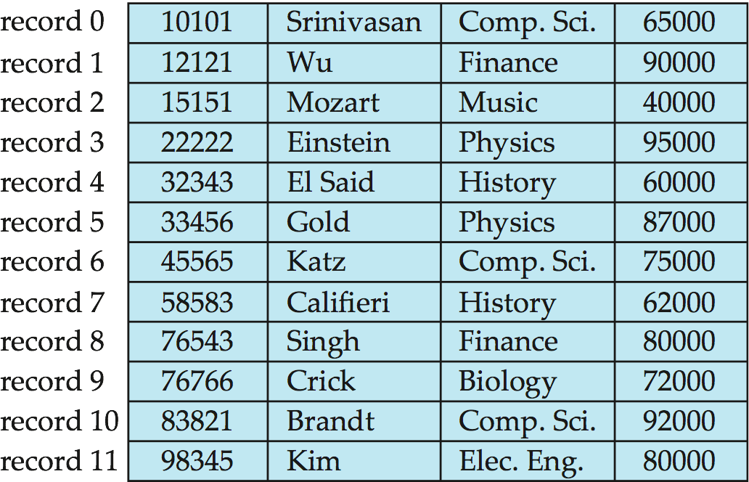
Fixed-Length Records
Simple approach:
Store record i starting from byte n * (i – 1), where n is the size of each record.
Record access is simple but records may cross blocks
Modification: do not allow records to cross block boundaries
Deletion of record i: alternatives:
move records i + 1, . . ., n to i, . . . , n – 1
move record n to i
do not move records, but link all free records on a free list
Notes:
‹#›

Slide 40
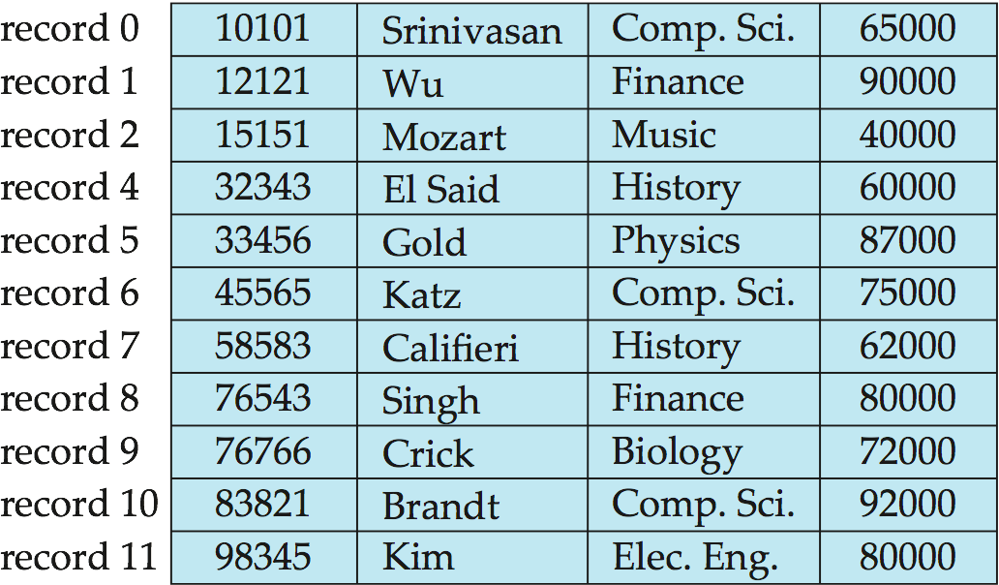
Deleting record 3 and compacting
Notes:
‹#›

Slide 41
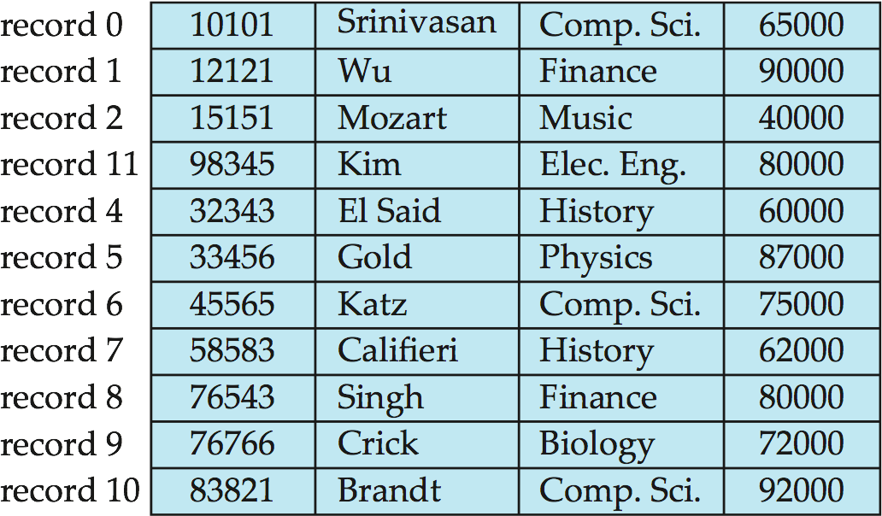
Deleting record 3 and moving last record
Notes:
‹#›

Slide 42
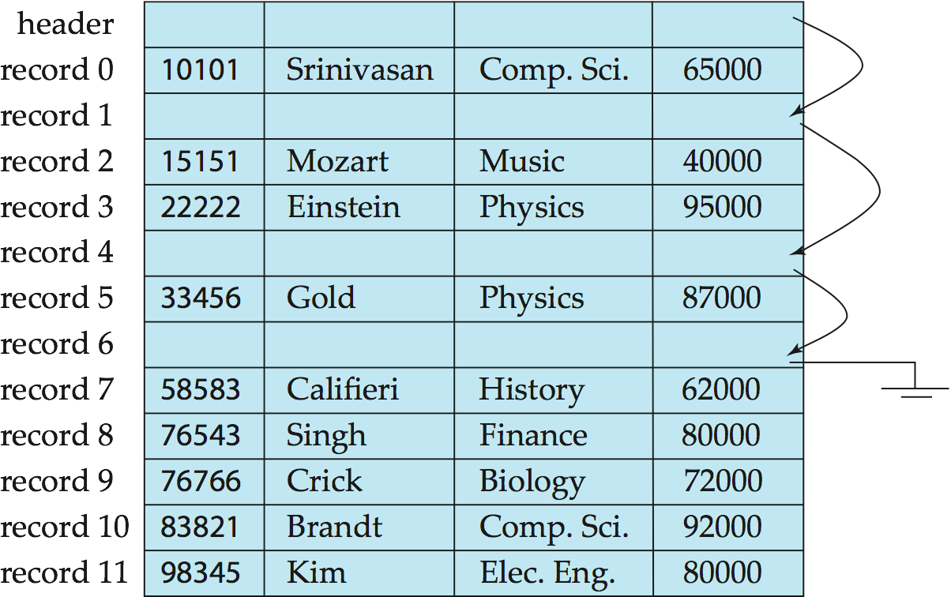
Free Lists
Store the address of the first deleted record in the file header.
Use this first record to store the address of the second deleted record, and so on
Can think of these stored addresses as pointers since they “point” to the location of a record.
More space efficient representation: reuse space for normal attributes of free records to store pointers. (No pointers stored in in-use records.)
Notes:
‹#›

Slide 43
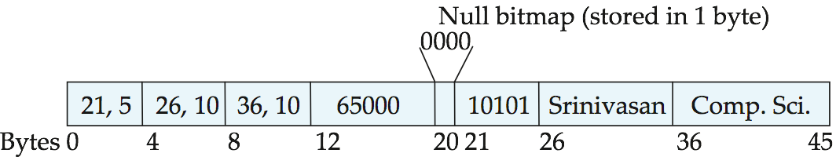
Variable-Length Records
Variable-length records arise in database systems in several ways:
Storage of multiple record types in a file.
Record types that allow variable lengths for one or more fields such as strings (varchar)
Record types that allow repeating fields (used in some older data models).
Attributes are stored in order
Variable length attributes represented by fixed size (offset, length), with actual data stored after all fixed length attributes
Null values represented by null-value bitmap
Notes:
‹#›

Slide 44
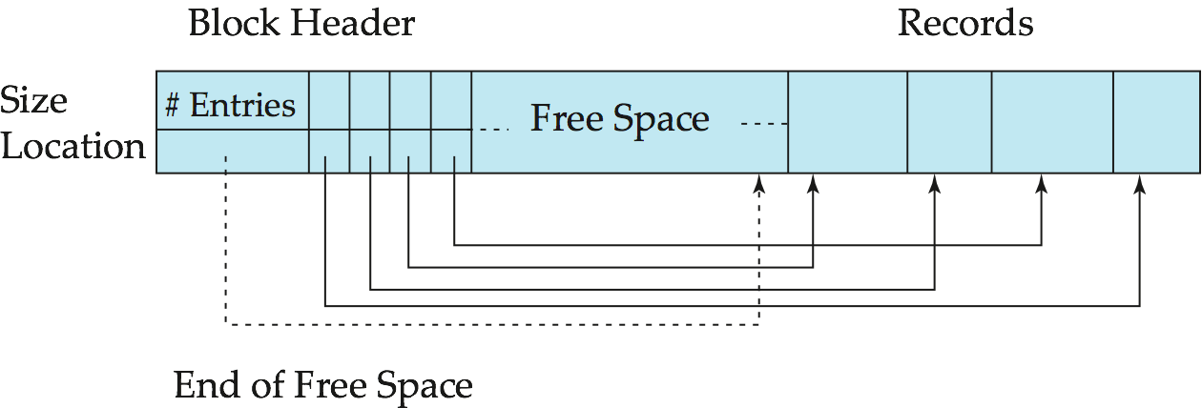
Variable-Length Records: Slotted Page Structure
Slotted page header contains:
number of record entries
end of free space in the block
location and size of each record
Records can be moved around within a page to keep them contiguous with no empty space between them; entry in the header must be updated.
Pointers should not point directly to record — instead they should point to the entry for the record in header.
Notes:
‹#›

Slide 45
Organization of Records in Files
Heap – a record can be placed anywhere in the file where there is space
Sequential – store records in sequential order, based on the value of the search key of each record
Hashing – a hash function computed on some attribute of each record; the result specifies in which block of the file the record should be placed
Records of each relation may be stored in a separate file. In a multitable clustering file organization records of several different relations can be stored in the same file
Motivation: store related records on the same block to minimize I/O
Notes:
‹#›

Slide 46
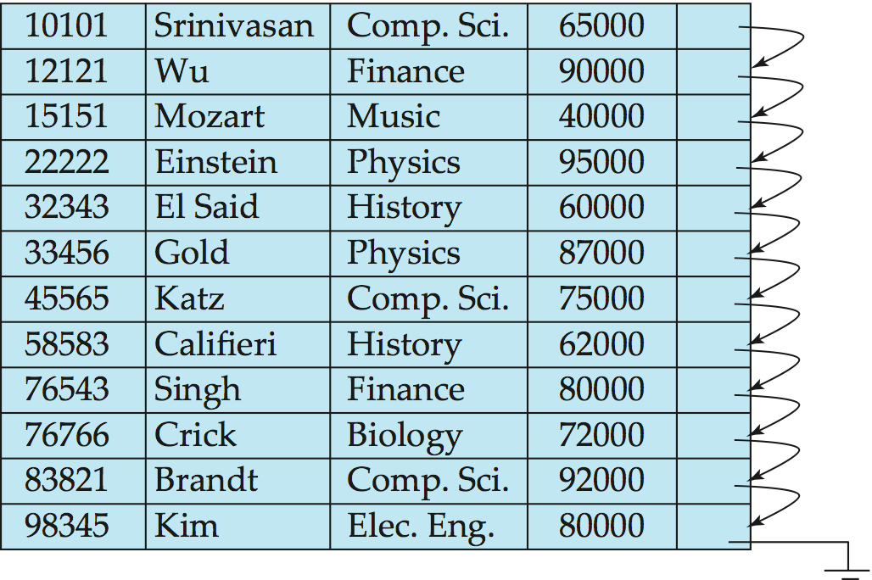
Sequential File Organization
Suitable for applications that require sequential processing of the entire file
The records in the file are ordered by a search-key
Notes:
‹#›

Slide 47
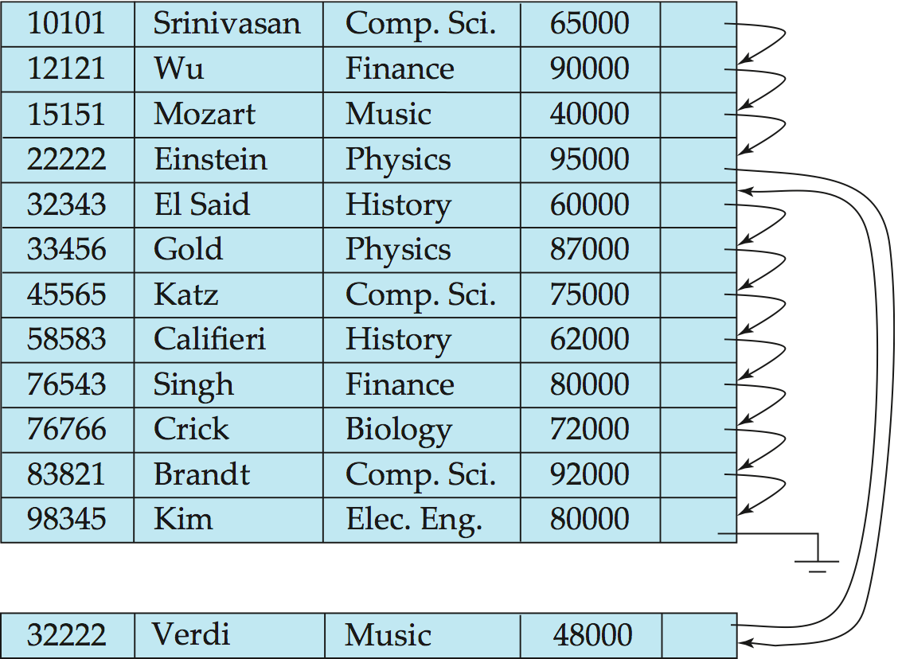
Sequential File Organization (Cont.)
Deletion – use pointer chains
Insertion –locate the position where the record is to be inserted
if there is free space insert there
if no free space, insert the record in an overflow block
In either case, pointer chain must be updated
Need to reorganize the file from time to time to restore sequential order
Notes:
‹#›

Slide 48
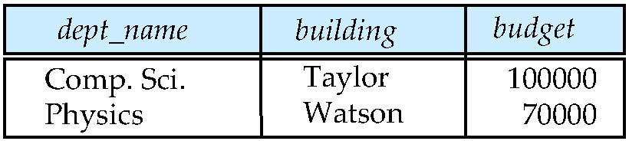
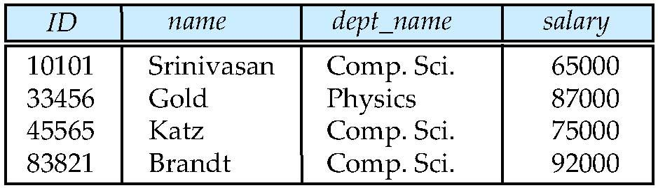
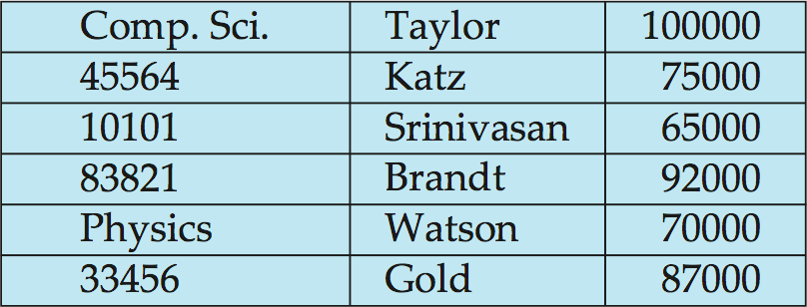
Multitable Clustering File Organization
Store several relations in one file using a multitable clustering file organization
department
instructor
multitable clustering
of department and
instructor
Notes:
‹#›

Slide 49
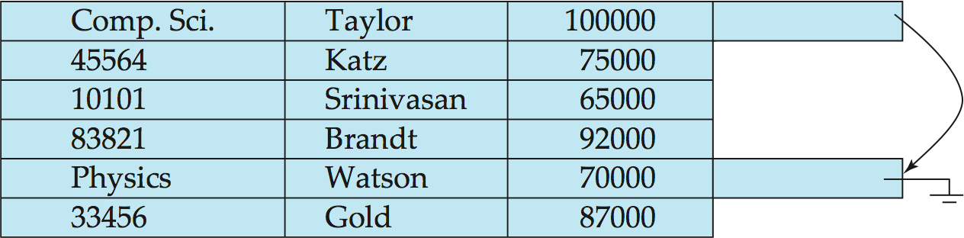
Multitable Clustering File Organization (cont.)
good for queries involving department instructor, and for queries involving one single department and its instructors
bad for queries involving only department
results in variable size records
Can add pointer chains to link records of a particular relation

Slide 50
Data Dictionary Storage
The Data dictionary (also called system catalog) stores metadata; that is, data about data, such as
Information about relations
names of relations
names, types and lengths of attributes of each relation
names and definitions of views
integrity constraints
User and accounting information, including passwords
Statistical and descriptive data
number of tuples in each relation
Physical file organization information
How relation is stored (sequential/hash/…)
Physical location of relation
Information about indices (Chapter 11)
Notes:
‹#›

Slide 51
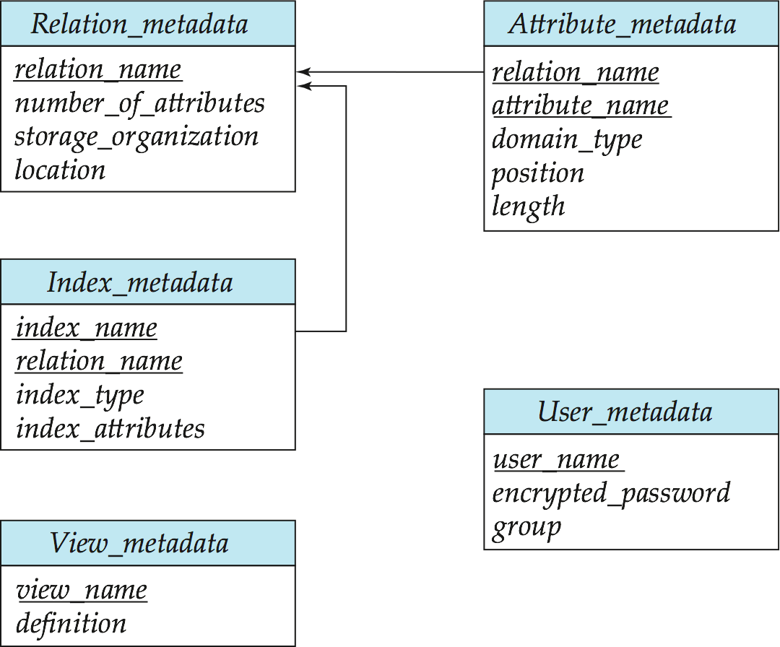
Relational Representation of System Metadata
Relational representation on disk
Specialized data structures designed for efficient access, in memory

Slide 52
Storage Access
A database file is partitioned into fixed-length storage units called blocks. Blocks are units of both storage allocation and data transfer.
Database system seeks to minimize the number of block transfers between the disk and memory. We can reduce the number of disk accesses by keeping as many blocks as possible in main memory.
Buffer – portion of main memory available to store copies of disk blocks.
Buffer manager – subsystem responsible for allocating buffer space in main memory.
Notes:
‹#›

Slide 53
Buffer Manager
Programs call on the buffer manager when they need a block from disk.
If the block is already in the buffer, buffer manager returns the address of the block in main memory
If the block is not in the buffer, the buffer manager
Allocates space in the buffer for the block
Replacing (throwing out) some other block, if required, to make space for the new block.
Replaced block written back to disk only if it was modified since the most recent time that it was written to/fetched from the disk.
Reads the block from the disk to the buffer, and returns the address of the block in main memory to requester.
Notes:
‹#›

Slide 54
Buffer-Replacement Policies
Most operating systems replace the block least recently used (LRU strategy)
Idea behind LRU – use past pattern of block references as a predictor of future references
Queries have well-defined access patterns (such as sequential scans), and a database system can use the information in a user’s query to predict future references
LRU can be a bad strategy for certain access patterns involving repeated scans of data
For example: when computing the join of 2 relations r and s by a nested loops for each tuple tr of r do for each tuple ts of s do if the tuples tr and ts match …
Mixed strategy with hints on replacement strategy provided by the query optimizer is preferable
Notes:
‹#›

Slide 55
Buffer-Replacement Policies (Cont.)
Pinned block – memory block that is not allowed to be written back to disk.
Toss-immediate strategy – frees the space occupied by a block as soon as the final tuple of that block has been processed
Most recently used (MRU) strategy – system must pin the block currently being processed. After the final tuple of that block has been processed, the block is unpinned, and it becomes the most recently used block.
Buffer manager can use statistical information regarding the probability that a request will reference a particular relation
E.g., the data dictionary is frequently accessed. Heuristic: keep data-dictionary blocks in main memory buffer
Buffer managers also support forced output of blocks for the purpose of recovery (more in Chapter 16)
Notes:
‹#›

Slide 56
End of Chapter 10
Notes:
‹#›

Slide 57
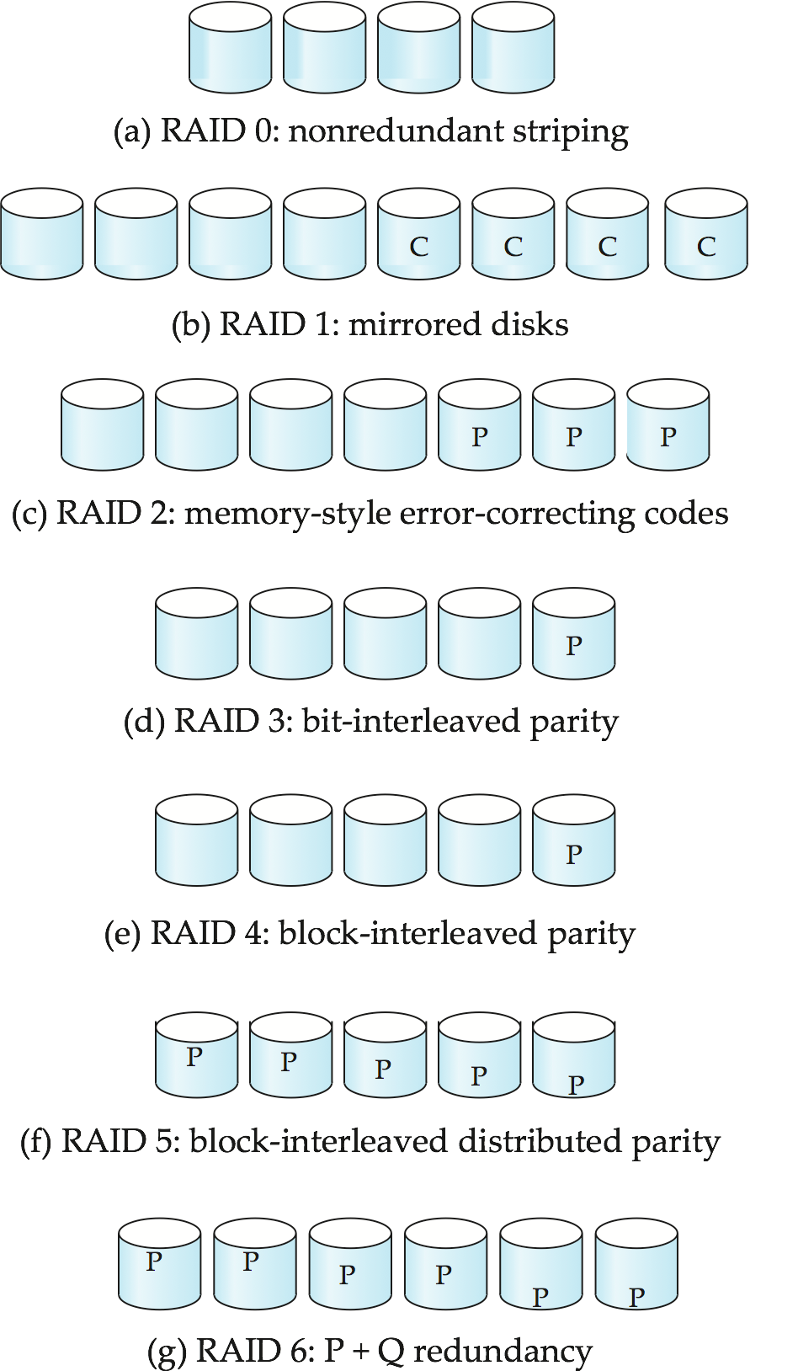
Figure 10.03
Notes:
‹#›

Slide 58
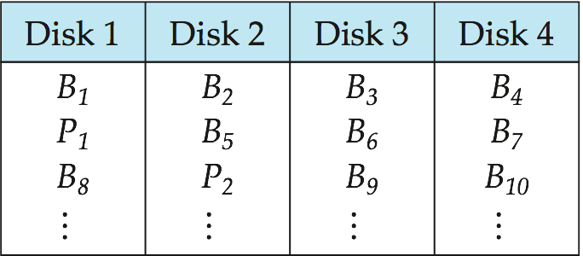
Figure 10.18
Notes:
‹#›

Slide 59

Figure in-10.1
Notes:
‹#›

